Slide 1


EMEA Technical Enablement Workshop
London, September 6th 2018

Slide 2
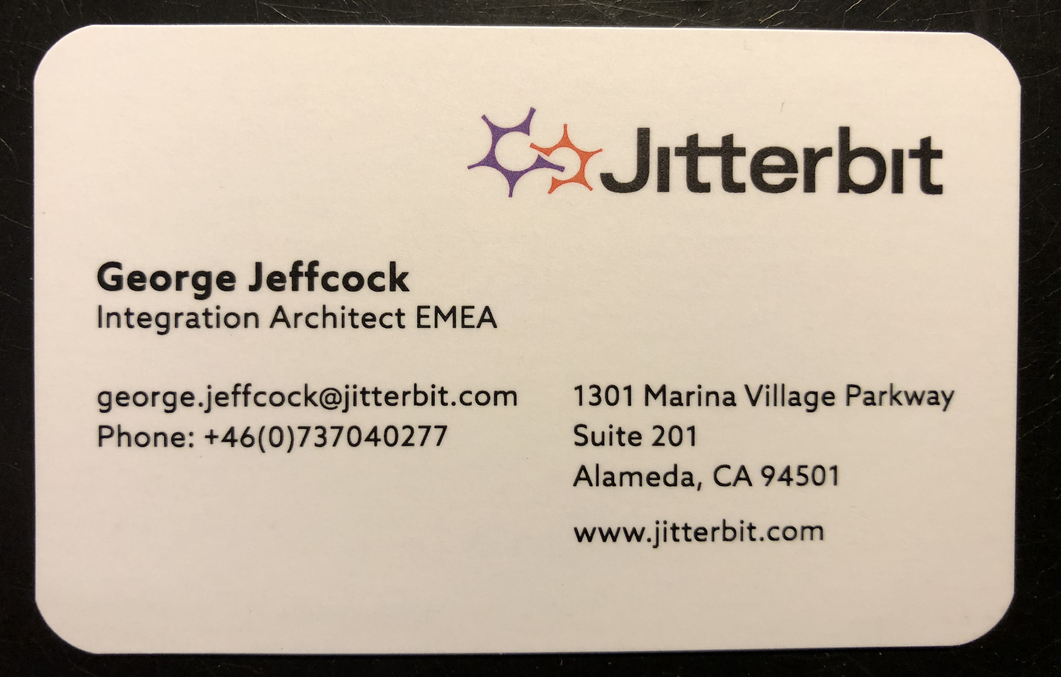
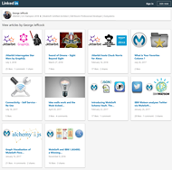
https://www.linkedin.com/today/author/georgejeffcock

Slide 3
Technical Enablement Workshop Agenda
Part1 Theory (10:00-12:00)
Tips, Tricks & Best Practice
Part2 Build Outs (12.30-14:00)
Salesforce Outbound Message
Dev Portal / Swagger / Real Time
Harmony API
Splunk / Update Project Variables
Open Floor

Slide 4


Too Fast - Shout Out
Too Quiet - Shout Out
Too Boring - Shout Out
Too Techy - Shout Out

Slide 5

Tips, Tricks & Best Practice

Slide 6
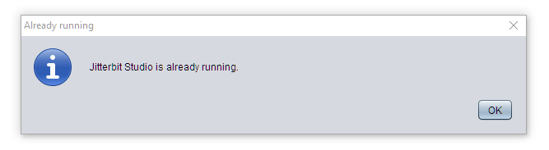


1. Tips, Tricks & Best Practice - Run Multiple Desktop Studios
Edit your C:\Program Files\Jitterbit Studio 9.2\configuration\client.properties file
STARTUP_ARGUMENTS='-Xms512m -Xmx1024m -Djava.util.Arrays.useLegacyMergeSort=true -DAllowMultipleInstances=true'

Slide 7
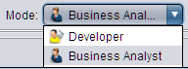
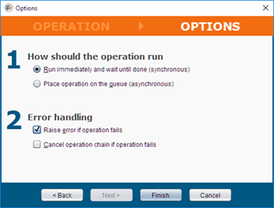
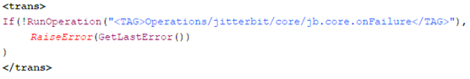
2. Tips, Tricks & Best Practice - Business Analyst Mode
Provides a wizard interface
Example RunOperation:
Result:

Slide 8
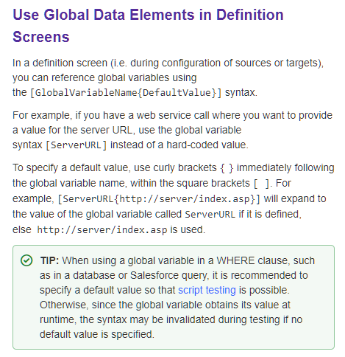
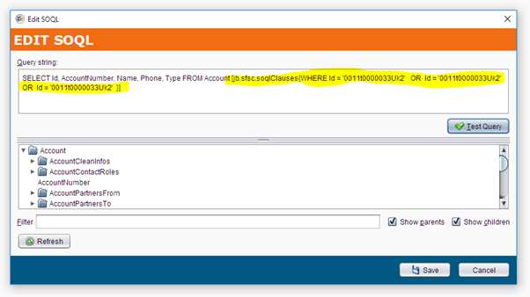
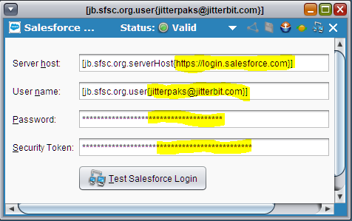
3. Tips, Tricks & Best Practice - Global Variable Default Values
https://success.jitterbit.com/display/DOC/Using+Global+Variables#UsingGlobalVariables-UseGlobalDataElementsinDefinitionScreens

Slide 9

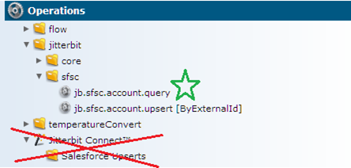
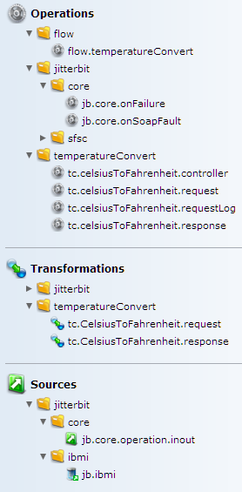
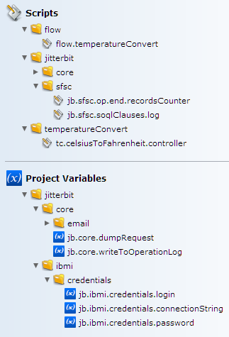
4. Tips & Tricks - Project Structure
Think Lego Duplo
The Bricks
Endpoint Folders
Common Folder
The Buildings
Flow Folder
Naming endpoint.entity.myAction

Slide 10

Tips & Tricks

Slide 11


5. Tips, Tricks & Best Practice - Discover Using API Client NOT eiPaaS platform
Discover http Published endpoints (REST, GraphQL, SOAP Services) NOT with Jitterbit
Use dedicated client:
SOAPUI / Postman
Connectivity / Authentication
Iterate quickly
Learn request details
Learn response Error details
Finally learn response success details
Then Consume into Jitterbit by modelling what you have learnt
We will reference:
https://www.w3schools.com/xml/tempconvert.asmx?WSDL

Slide 12
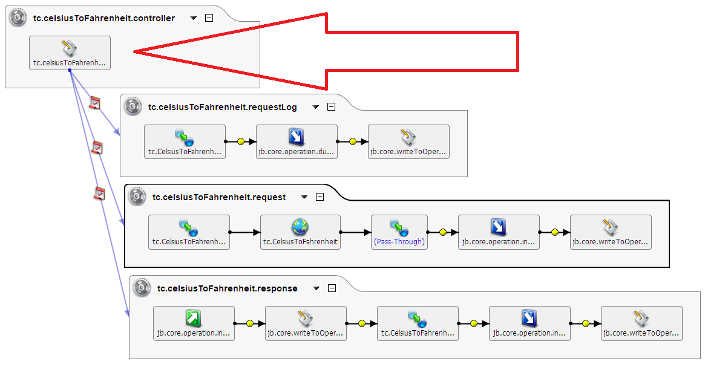
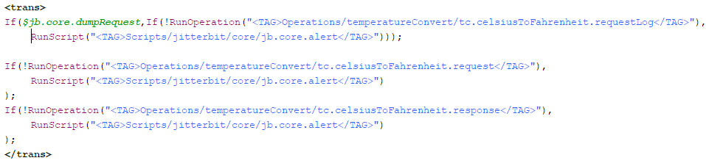
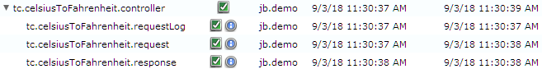
6. Tips, Tricks & Best Practice - Script Operation: Orchestrate to Success
Orchestrate to Success
Controller/Marshaller/Orchestrator
Script Operation
Graceful Error Handling
Enables operation re-use
Enables Flow Testing / Debugging
https://success.jitterbit.com/display/DOC/Running+Next+Operations+Conditionally+Using+Operation+Chains#RunningNextOperationsConditionallyUsingOperationChains-Example2

Slide 13
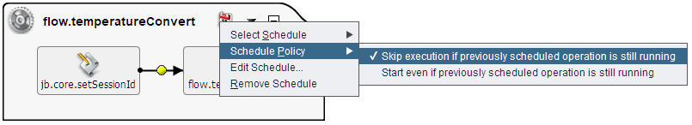

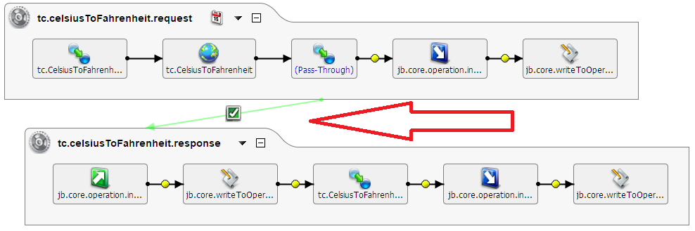
6. Tips, Tricks & Best Practice - Script Operation: Orchestrate to Success
On Success Path
Please consider:
Tight coupling of operations
Skip Execution implementation
Graceful error handling
No Records Error
https://success.jitterbit.com/display/DOC/Running+Next+Operations+Conditionally+Using+Operation+Chains#RunningNextOperationsConditionallyUsingOperationChains-Example1
Skip Execution Implementation
Extremely useful
But..make sure operation remains running

Slide 14
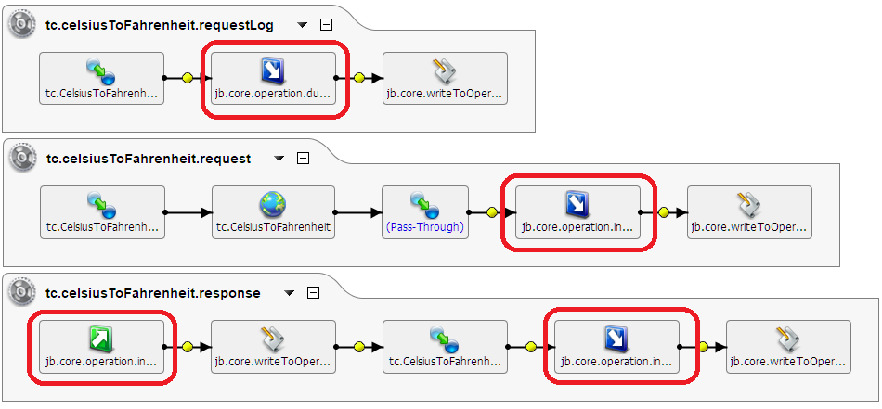
7. Tips, Tricks & Best Practice - Global Variables as Target & Source
Use as a source and target within operations (Global Variable Source and Global Variable Target)
Write to Memory not to Disk
You only need one(ish)
Clean up after themselves
No more buffer and flushFile bugs
Enables Re-Use
WriteToOperationLog Script
Interoperability

Slide 15
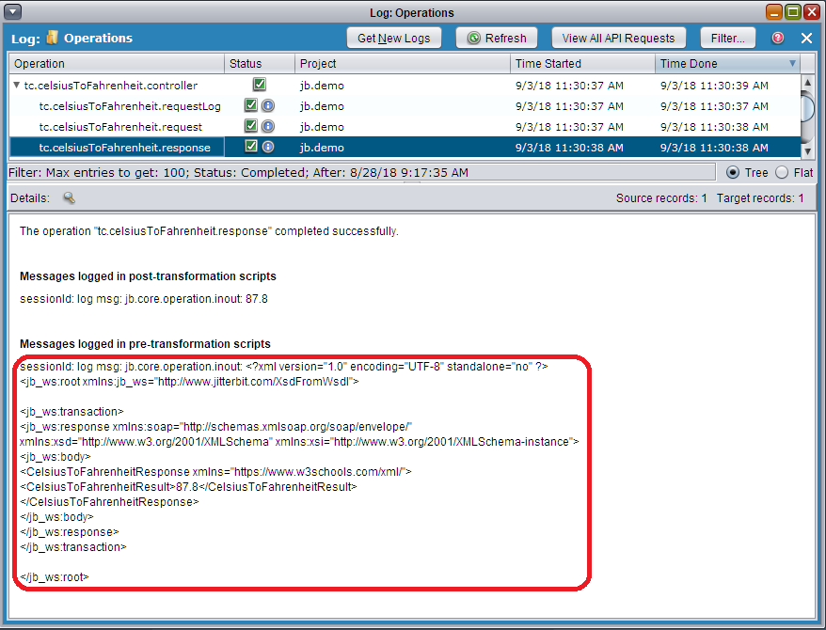
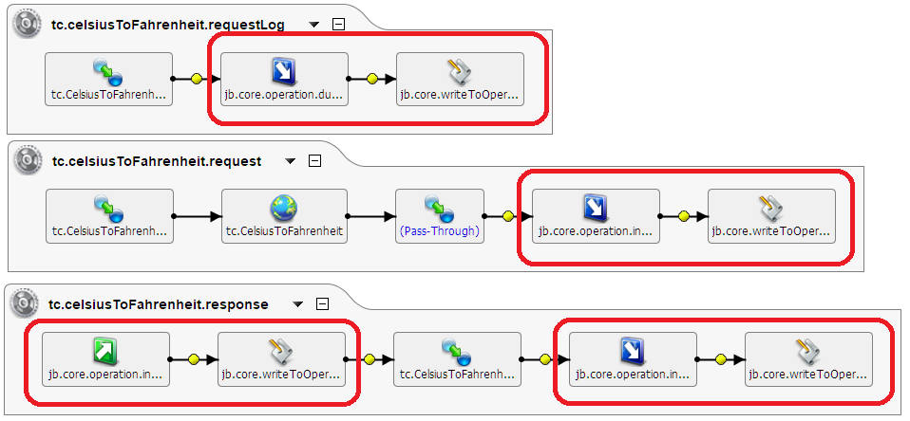
8. Tips, Tricks & Best Practice - WriteToOperationLog Source & Target
Endpoint Request & Responses
Invaluable in development and production issues
Identify what tier is in error fast
Cherish the (Pass-Through)
Plays well with one Source / Target Global Variable

Slide 16
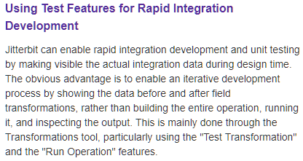
9. Tips & Tricks - Design Time Development
Strongest low-code design time tools on the market! So use it.
Test Transformation
Test Query
Enabled by:
Tip 3 Global Variable Default Values
Tip 6 Script Operation: Orchestrate to Success
Tip 7 Global Variables as Target & Source
Tip 8 WriteToOperationLog Source & Target
Success Central: Using Test Features for Rapid Integration Development
Test Examples and Schema are Project Deliverables !

Slide 17
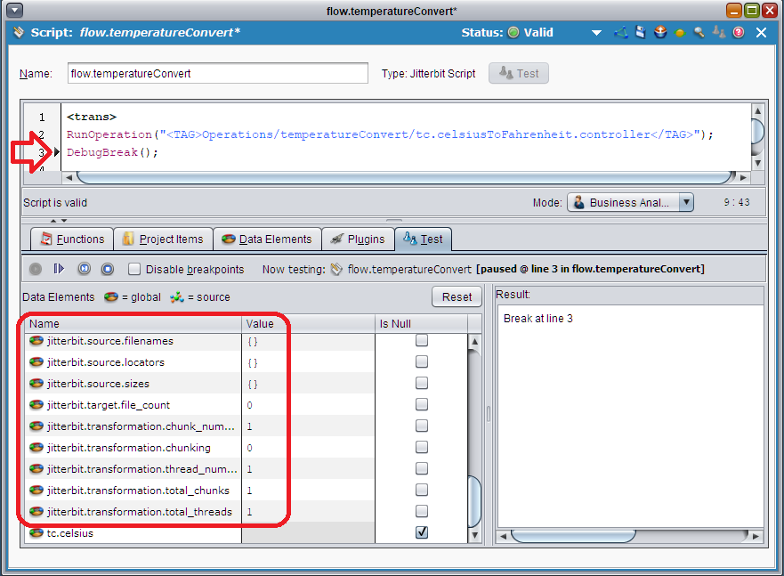
9. Tips & Tricks - Design Time Development
Test and Debug flows
Now we have a Script Operation as the Controller we can harness
https://success.jitterbit.com/display/DOC/Creating+a+Script#CreatingaScript-Test
https://success.jitterbit.com/display/DOC/Debugging+Functions
Awareness of Jitterbit Predefined Global Variables
Step through your flow

Slide 18
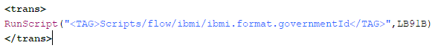
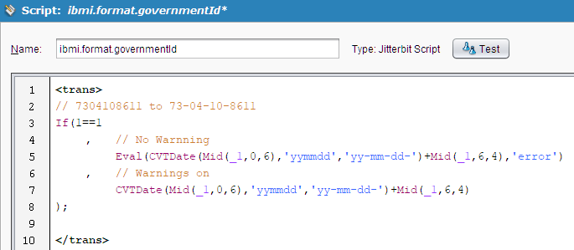
10. Tips, Tricks & Best Practice - Externalize, Externalize & Externalize
Externalize scripts for re-use
Transformations
Validation
Initialization
Query Statements
We do not want to be searching around target nodes for a bit of logic and worse still managing multiple copies

Slide 19
ibmi.badDebit

Slide 20
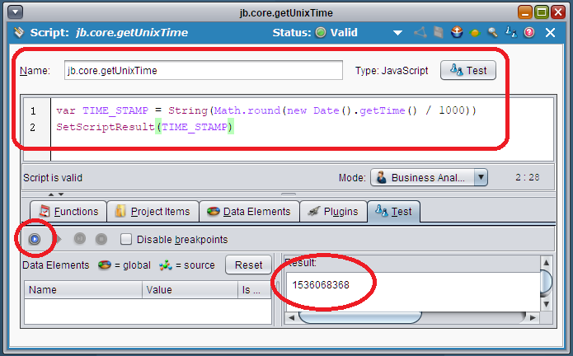
11. Tips, Tricks & Best Practice - JavaScript
jb.core.getUnixTime
jb.netsuite.tokenPassword.signature
success.jitterbit.com JavaScript

Slide 21
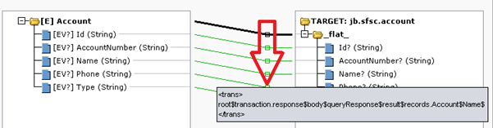
Tips, Tricks & Best Practice Bonus
Hover over to see mapping instead clicking into mapping node

Slide 22

Build Outs

Slide 23
Thank You for Participating

